Slide 1
Drug Court Foundations:
Community Backing and Buy-In!
Dianne Marshall
Founder and President, Board of Directors, California Collaborative Justice Courts Foundation

Slide 2
Opening Remarks
Acknowledgement of the Need:
  Fiscal Environments and Shrinking Budgets
  Nearly 200 technical assistance requests received
Acknowledgement of the Challenge
Over 20 known Collaborative Court Foundations Nationally
Getting Connected and Learning from Others

Slide 3
Goals for Today
Introduction to four Collaborative Court Foundation
Gain an understanding of key ingredients of an effective Collaborative Court Foundation
Gain an understanding of common challenges faced by Collaborative Court Foundations
Cross Panel Discussion
Questions and Answers

Slide 4
1
2
3
4
Harris County Drug Court Foundation (Texas)
Drug Treatment Court Foundation of Kalamazoo County (Michigan)
Nashville Drug Court Support Foundation (Tennessee)
California Collaborative Justice Courts Foundation
Today’s Panel

Slide 5
Harris County
Drug Court Foundation
(Texas)

Slide 6

Established in 2003 and granted 501(c)(3) status in 2006
Mission - provide financial support to the Harris County’s STAR (Success Through Addiction Recovery) felony drug court program
Raise awareness in the community about the life saving, fiscally responsible activities of the STAR program

Slide 7
Board of Directors
Devon Anderson—Attorney at Law, Partner, Anderson & Thomas, PLLC; Former Judge of the 177th District Court
Katherine Cabaniss—Executive Director, Crime Stoppers of Houston
Christel Erickson – Collins - LCSW
Deborah Keyser—Attorney at Law
Apriel Powell-Martin—Privacy Attorney, St. Luke’s Episcopal Health System
Frank Rynd—General Counsel, Roman Catholic Archdiocese of Galveston / Houston; former judge of the 309th District Court
Brock Thomas—Attorney at Law, Partner, Anderson & Thomas, PLLC; former judge of the 338th District Court

Slide 8
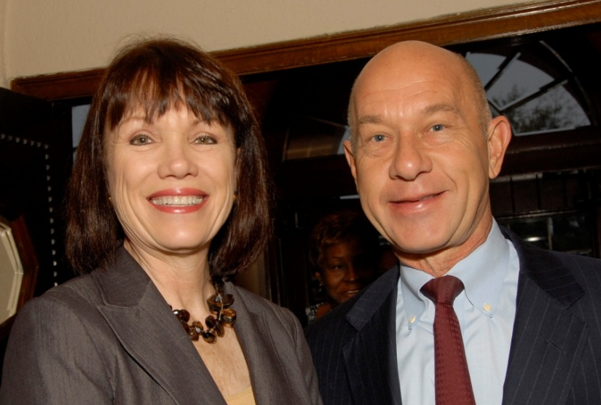
Roles of the Board
Garnering community support
Advocating for drug courts with local elected officials and policymakers
Balancing ethical concerns for current judges and staff
Board Member Deborah Keyser and Texas State Senator John Whitmire at Annual Foundation Breakfast

Slide 9
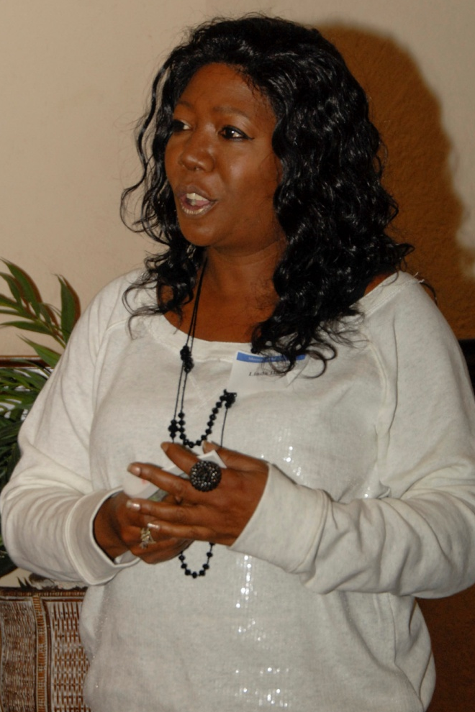
Alumni Involvement
Two STAR Alumni members are on the HCDCF Advisory Board
Yearly Distinguished Alumni Award
First STAR Alumni Distinguished Award Winner

Slide 10
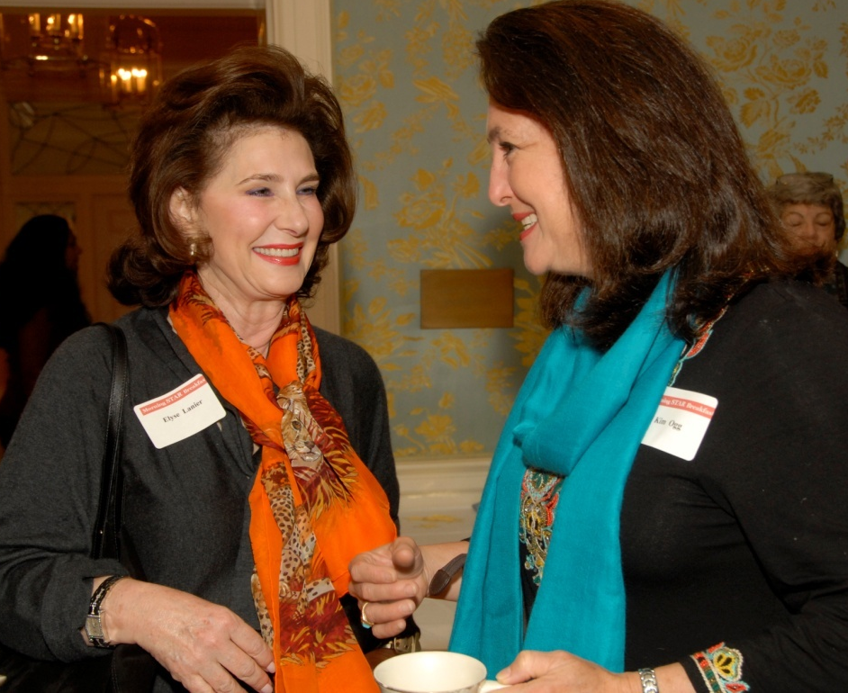
Fundraising
Challenges
  - Judicial ethics
Events
  - Annual breakfast
  - Fall Art Social
Grant writing
Acquiring donations

Slide 11
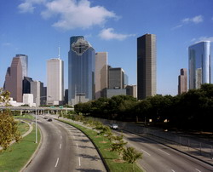
Target Population
Adult Drug Court
  - Program Capacity: 160
  - Total Graduates: 322
Large County in Houston, Texas
Mostly indigent population
  - Homelessness
  - Transportation issues
  - Medical and dental issues
  - Mental health and trauma Issues

Slide 12
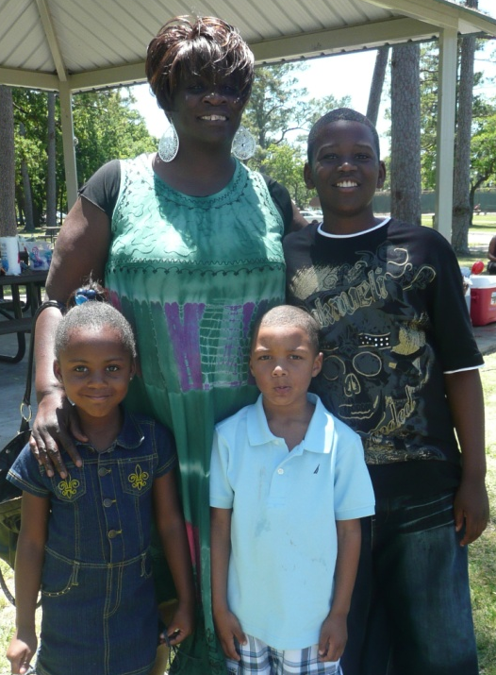
Specific Uses of Funds
Transitional housing
Dental and medical care
Individualized therapy
  - Family and mental health
  - Grief and trauma counseling
Drug Court events
  - Spring picnic
  - Alumni holiday party
  - Quarterly wellness walks

Slide 13
Community Awareness
Presentations to several local legal, professional, and faith communities
  - Houston Downtown Rotary Club
  - Exchange Club
  - Archdiocese of Galveston-Houston
Social Media
  - Website
  - Facebook page

Slide 14
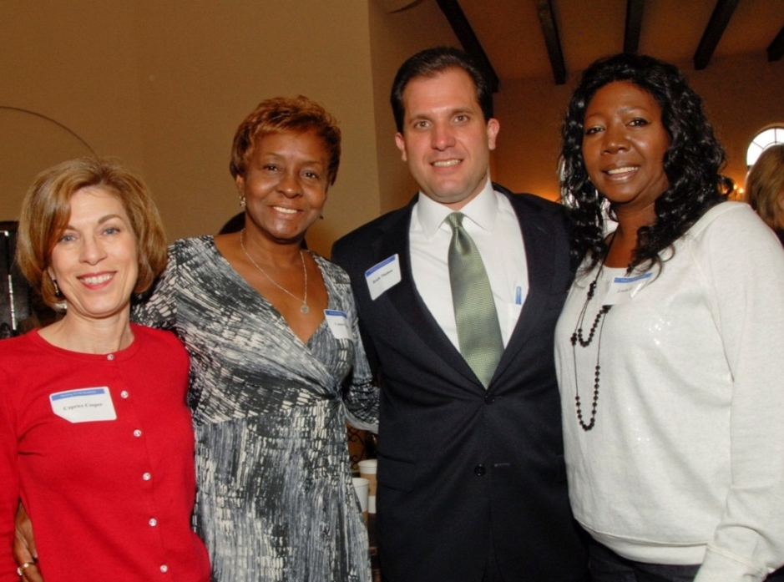

Contact Information
Harris County Drug Court Foundation
3217 Montrose Boulevard
Houston, Texas 77006
Email: info@hcdcf.org
Website: www.hcdcf.org

Slide 15
Drug Treatment Court Foundation of Kalamazoo County
(Michigan)

Slide 16
Background
Established in 2003
Goals - Finance, Educate, Advocate
Structure of the Foundation:
- Campaign Manager/Fund Raiser
- Campaign Cabinet
- Board of Directors
- Executive Committee
- Marketing/Development Committee
- Governmental Relations Committee
- Finance Committee

Slide 17
Strengths and Challenges
Strengths
- Evaluation
- History of the court
- Advisory Council
- Case Statement
- Philanthropic community
- Professional manager
- Persistence
- Public/private partnerships
- Court visits
- Gatherings
- Public Presentations
- Committee Structure
Challenges
- Sustenance
- Endurance
- Political and economic environment

Slide 18
Recommendations & Lessons Learned
Begin by determining clearly how much is to be raised
Judicial ethical position and participation is critical
Transparency/participation of AOC
Committee Structure
Be Flexible

Slide 19
Additional Information
Distinguish original Board from sustaining Board
Successful fundraising – professional; involve foundations; involve public; public relations; relationships
Marketing – get a professional to volunteer
Ethics – State Bar Ethics Committee; ABA Formal Opinion 08-452, October 17, 2008: Judges Soliciting Contributions for “Therapeutic” or “Problem-Solving Courts”

Slide 20
Contact Information
Honorable William G. Schma Circuit Court Judge (ret), President
Drug Treatment Court Foundation of Kalamazoo County
E-Mail: wschma@sbcglobal.net
Web: drugcourtfoundation.org
Phone: (269) 491-2214

Slide 21
The Nashville Drug Court
Support Foundation, Inc.
(NDCSF)

Slide 22
Nashville Drug Court Support Foundation
    Established in 1996
    The mission: to help generate support and provide direct service support for the Davidson County Drug Court (DC4) and educate others about the link between substance abuse and crime.
    DC4 utilizes an “integrated court model” combines supervision and treatment for addiction and co-occurring mental health disorders while still holding the offender accountable for their criminal behavior.
    The goal is to reduce incarcerated populations, and lower recidivism rates and societal costs associated with repeat offenders who suffer from addictive disorders.
Notes:
The Nashville Drug Court Support Foundation (NDCSF) is a community-based non-profit organization established in 1996 to help the substance abuse problem in the local criminal justice system. The mission of the NDCSF is to help generate support and provide direct service support for the Davidson County Drug Court (DC4). DC4 (Developing Character During Confinement – Davidson County Drug Court) was established in 1996 as a sentencing alternative designed to divert non-violent felony offenders from Tennessee’s penal system and instead place them in a long-term court program of recovery. The DC4 concept utilizes an “integrated court model” combines supervision and treatment for addiction and co-occurring mental health disorders while still holding the offender accountable for their criminal behavior. The goal is to reduce incarcerated populations, and lower recidivism rates and societal costs associated with repeat offenders who suffer from addictive disorders. Without the support of organizations like the NDCSF, many offenders would not receive the treatment they need to achieve long-term sobriety.

Slide 23
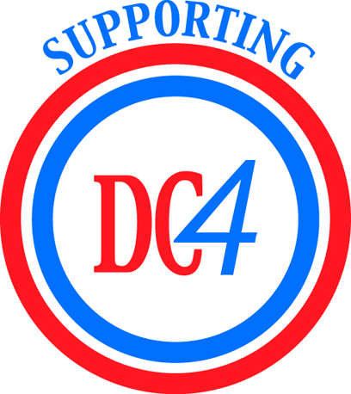
Nashville Drug Court Support Foundation
    Works in collaboration with current DC4 participants and alumni to provide drug and alcohol abuse and education programming to hundreds of youth each year.
    Partners with the Davidson County Mental Health Court to help provide residential specialty court program services to participants in the Mental Health Court Program.
    Works with agencies and stakeholders at the federal, state and local levels to help increase public awareness about the link between crime and substance abuse disorders.
    Believes that if such issues are adequately and properly addressed that social, criminal and economic costs (including healthcare) could be reduced commensurately.

Slide 24
Nashville Drug Court Support Foundation
In 2004, the NDCSF became a fully operational organization with a staff of (3) three full-time employees including: an executive director, office manager and research and housing coordinator.

Slide 25
Nashville Drug Court Support Foundation
Solicits funds needed for general operating costs of DC4.
Provide direct services support to DC4 (research and internal evaluation and coordination between DC4 and other programs and agencies).

Slide 26
Key Accomplishments 2004 - Current
Expanded the Nation’s only court operated drug program with it’s own residential facility to include:
  - A statewide methamphetamine program
  - Programs for offenders with co-occurring disorders
  - Assisted the 13th Judicial District in Tennessee with planning a similar program to DC4 in rural East Tennessee.
Assisted Tennessee Methamphetamine Task Force
  - Panel discussions (outside of courtroom)
  - Addicts share insight without fear of prosecution
Tennessee Integrated Court Support Initiative
  - More efficient/effective response toward trafficking and abuse of illicit drugs

Slide 27
Key Accomplishments 2004 - Current
  DCMHC
  Washington and Rutherford Counties received United States Department of Justice funding to develop and implement Mental Health Courts to serve their respective counties utilizing the DCMHC model as their template.

Slide 28
NDCSF Relationships
NDCSF works with
  - Federal
  - State
  - Local
Support results in
  - Reduction in social, criminal and economic costs (including healthcare)
  - Increased treatment for offenders
  - Long-term sobriety for many offenders

Slide 29
NDCSF Goal
Our Goal is to act as a statewide best practice model to ensure that each county within the state of Tennessee, through developing local, state and federal legislation provide the foundation for an integrated court system.

Slide 30
In the Davidson County Criminal Court System
80% off all cases involve drugs or alcohol
At least 60% charged in these cases have chemical dependency problems

Slide 31
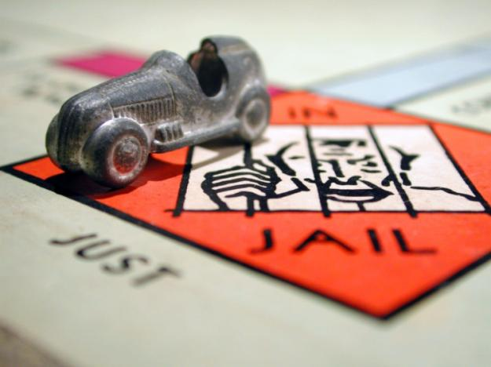
65% will re-offend within 3 years of their release if not treated for their addictions
Photo by Mark Strozier

Slide 32
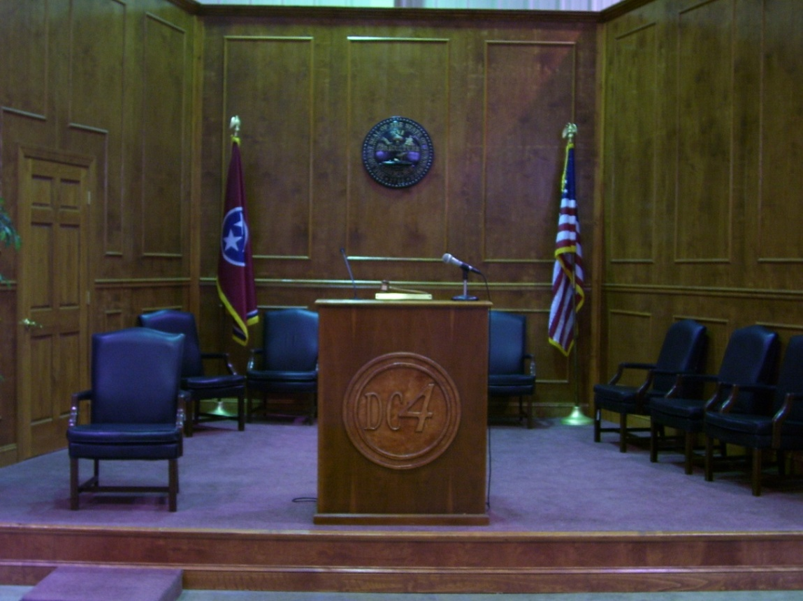
The Solution
Davidson County Drug Court

Slide 33
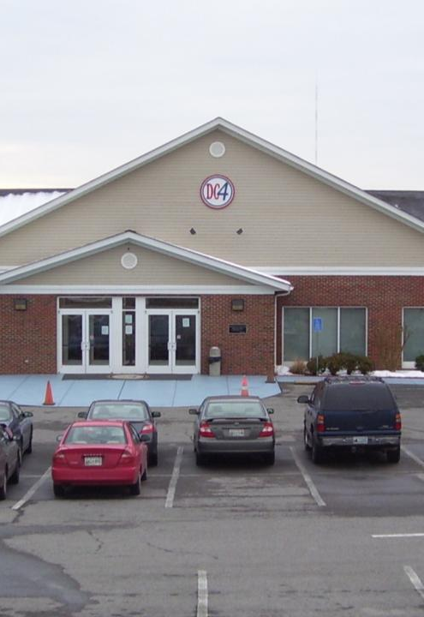
Our Mission
The Davidson County Drug Court Program is committed to providing a quality therapeutic community to promote positive change in criminal and addictive behaviors for the purpose of reintegrating adult offenders into society.

Slide 34
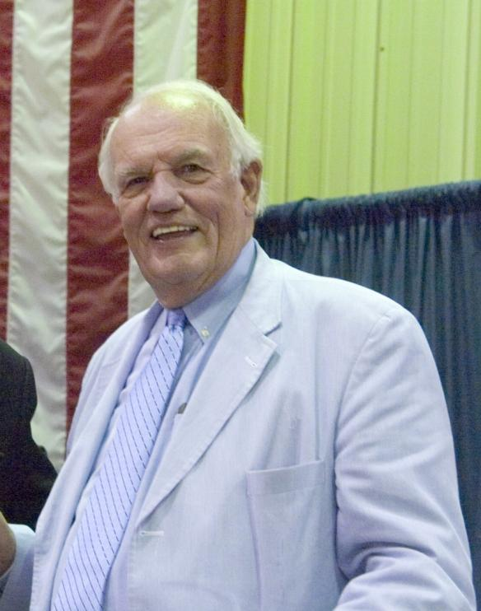
Judge Seth Norman
Founder and Presiding Judge of the Davidson County Drug Court
Founder and former Chairman of the Nashville Drug Court Support Foundation

Slide 35
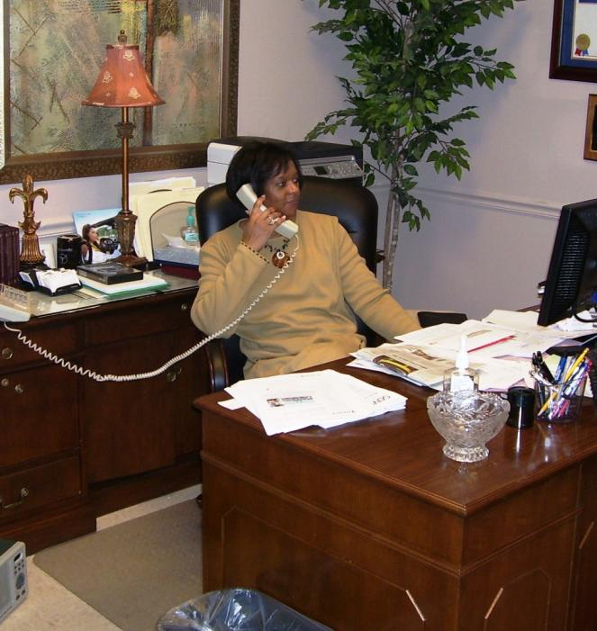
Janet Hobson, M.S.
Program Director for the Davidson County Drug Court Program

Slide 36
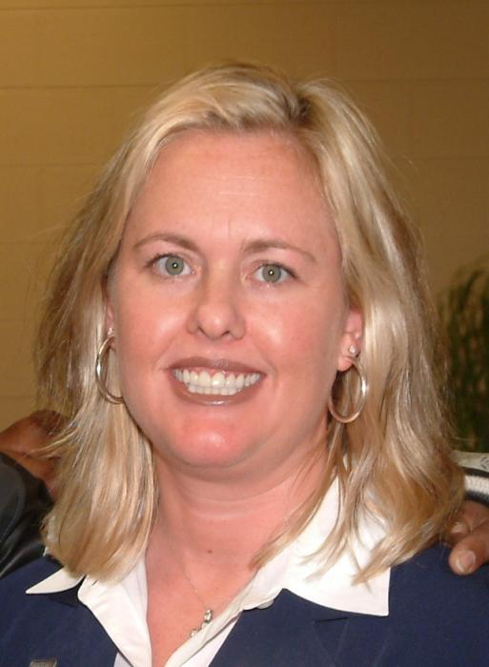
Jeri Holladay-Thomas, M.C.J.
Director for Nashville Drug Court Support Foundation (NDCSF)

Slide 37
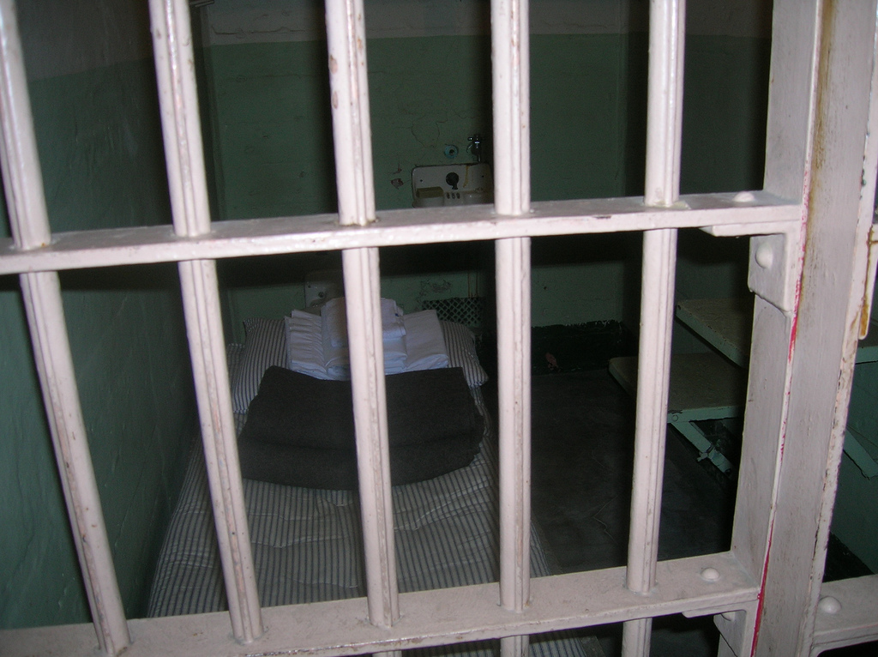
Prison Bars by Ken Mayer
Our participants are multiple felony offenders who have long histories of drug offenses. Average participants have more than 8 previous drug charges and have been previously incarcerated from two to four years.

Slide 39
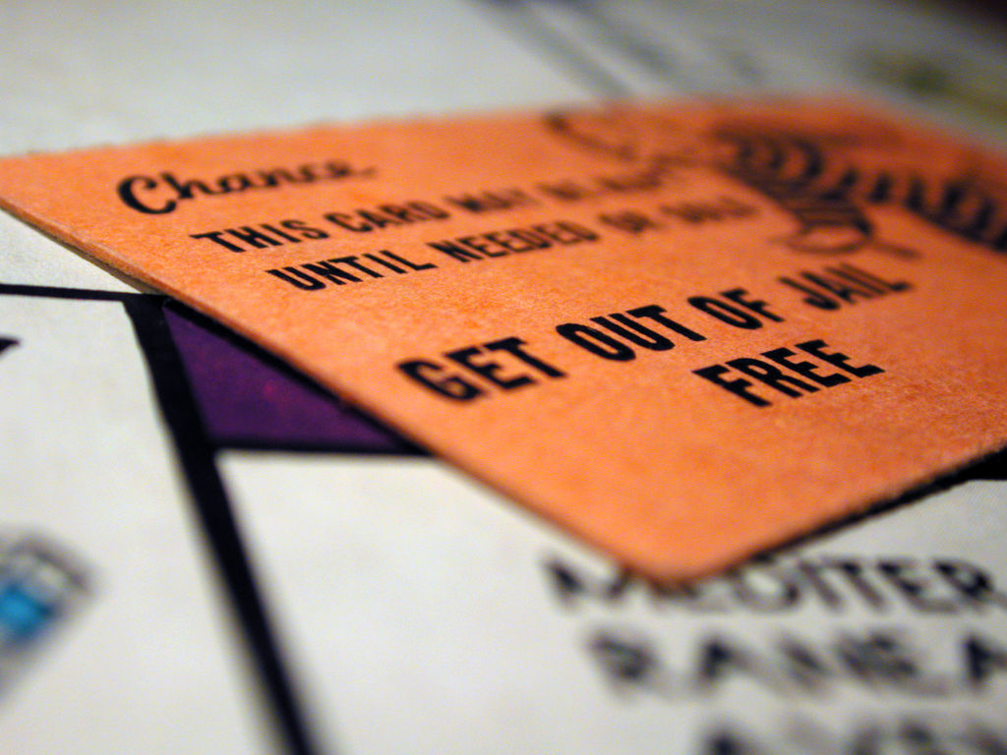
The program is NOT a get out of jail free card. This program is made to relieve the burden on the judicial system.
Photo by Mark Strozier

Slide 40
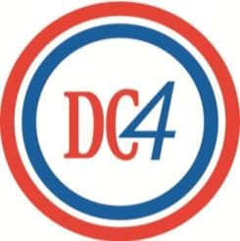
Program Components
Residential Program
Meth Program
Mental Health
NDCSF
Intensive Outpatient
Re-entry

Slide 41
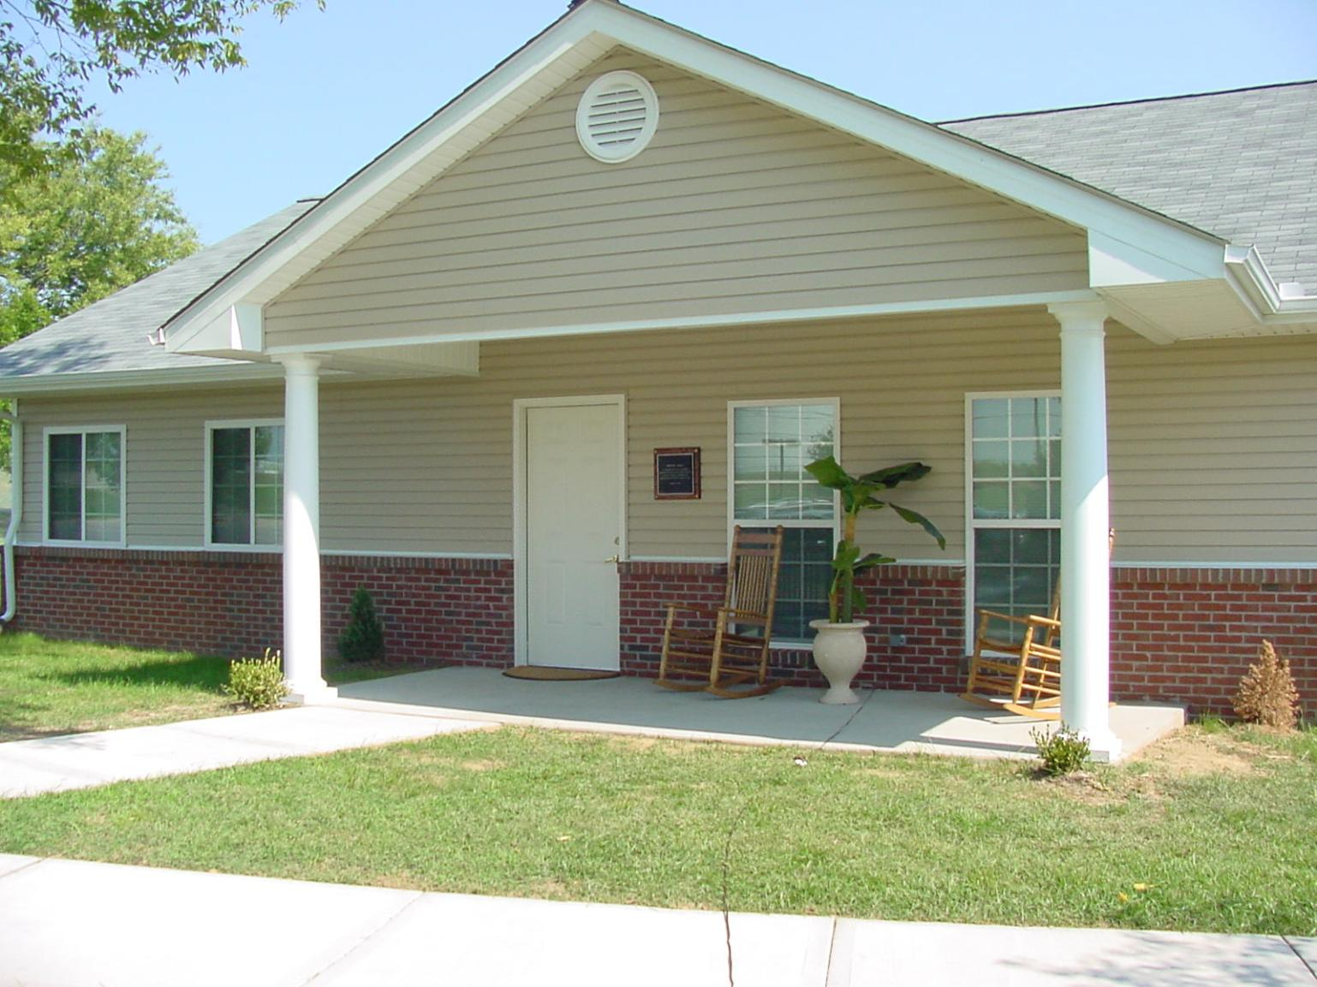
Residential Program
Considered the only Drug Court with it’s own residential facility
Intakes non-violent adult felony offenders from Davidson County and across the state
Residents are responsible for maintaining the facilities and grounds
HOW CAN THE FOUNDATION HELP WITH RESIDENTIAL TREATMENT PROGRAMS?

Slide 42
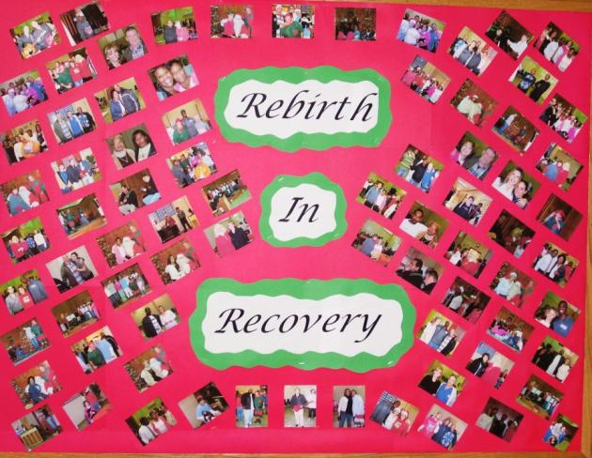
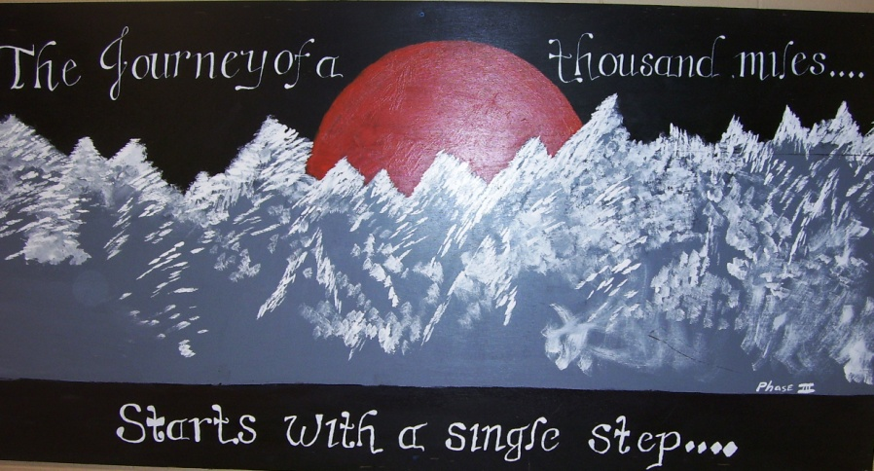
Phase I – Assessment and Orientation
Phase II – Stabilization and Rehabilitation
Phase III – Re-entry and Employment
Aftercare
Phase Descriptions

Slide 43
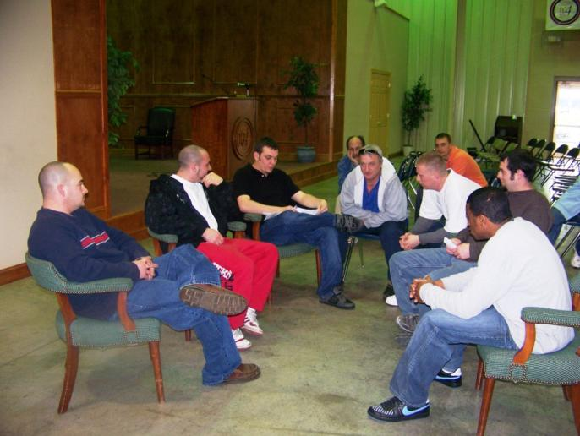
Meth-Offenders Program
Established in 2005
Participants come from across Tennessee
More intensive psychiatric and education
Extended up to 24 months
Servicing 29 Counties to date

Slide 44
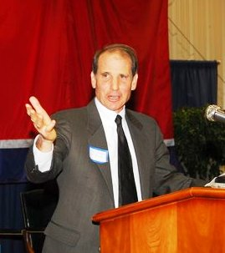
Mental Health Court Residential Program
Presiding Judge Dan Eisenstein
Abbreviated version of residential program, lasting about 90 days – 6 months
Referred through Davidson County Mental Health Court
64 offenders served to date with a 72% retention rate

Slide 45
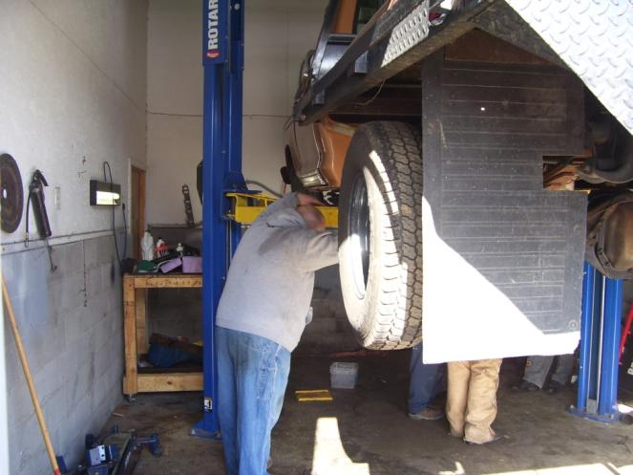
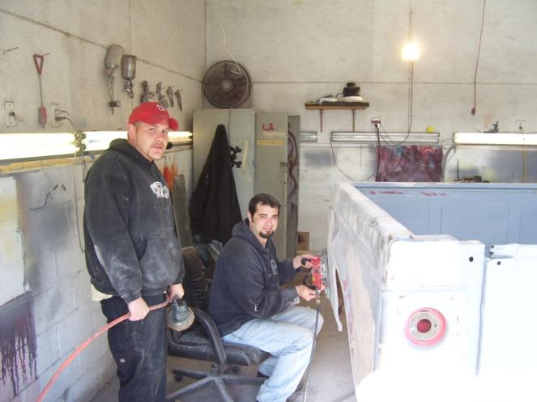
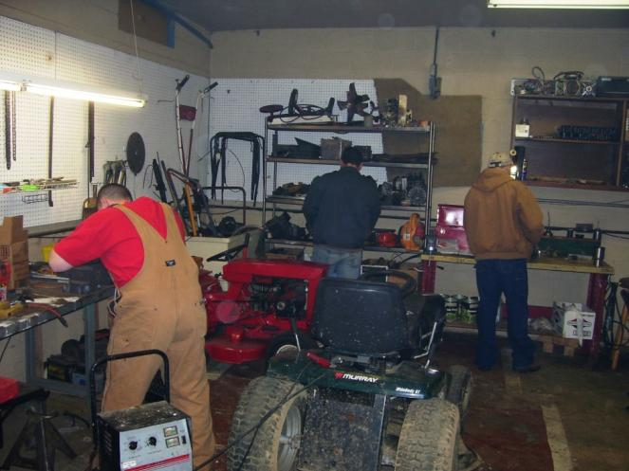
Automotive Repair
Vocational Training
Small Engine Repair
Auto Painting

Slide 46
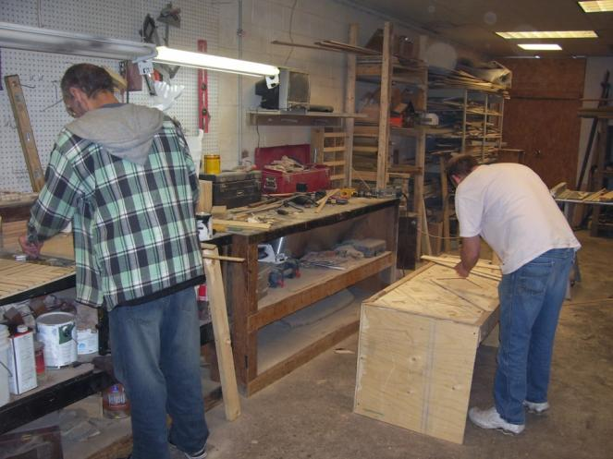
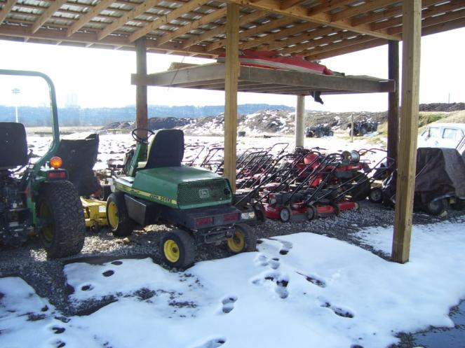
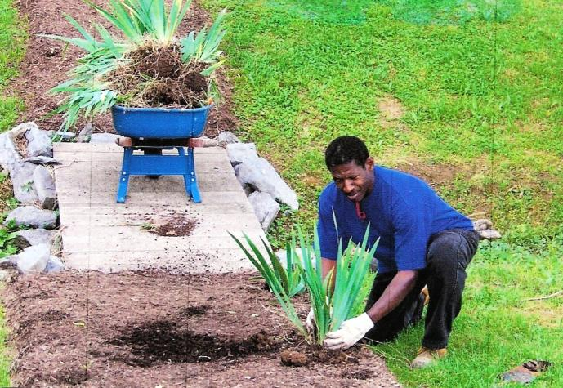
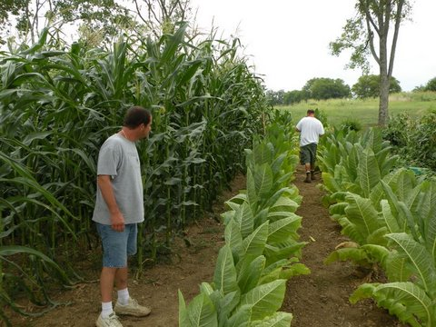
Landscaping & Lawn Care
Woodworking
Landscaping
Farming

Slide 47
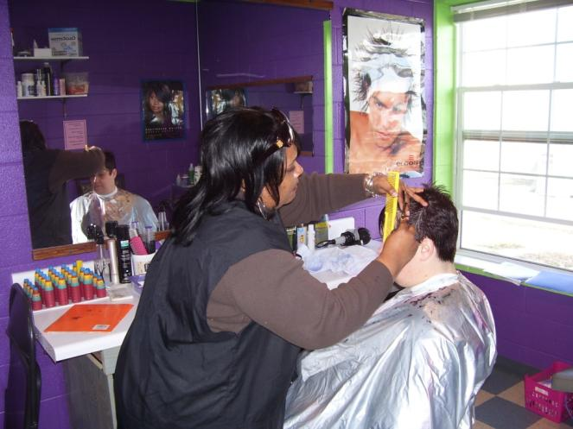
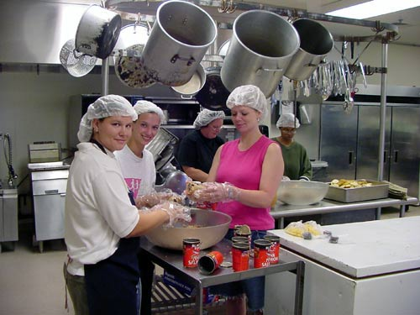
Vocational Training
Beauty Salon
Culinary Arts

Slide 48
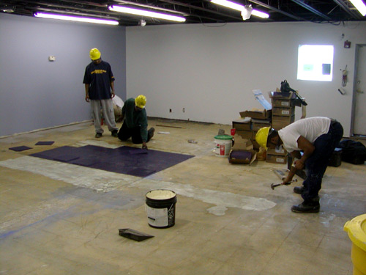
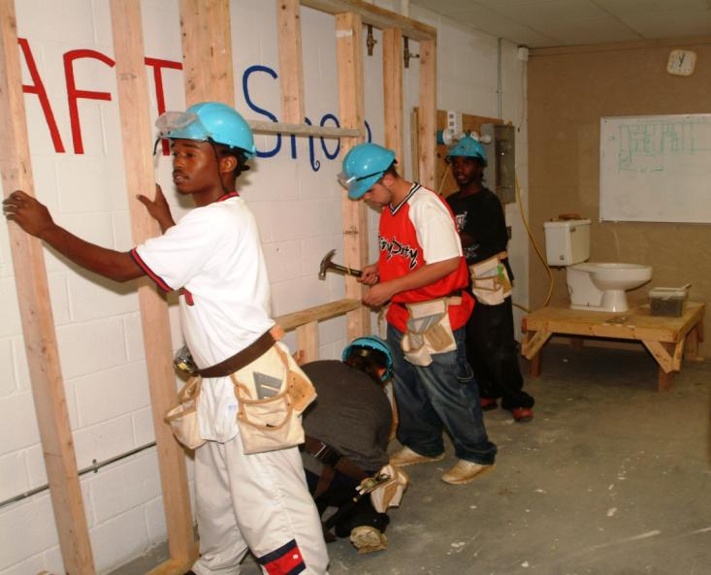
Public Service Work
Over 75,000 hours annually
  - Non-profits
  - Habitat for Humanity
  - Catholic Charities
  - Government agencies
  - Building projects
Alcohol & Drug Council Remodel Project

Slide 49
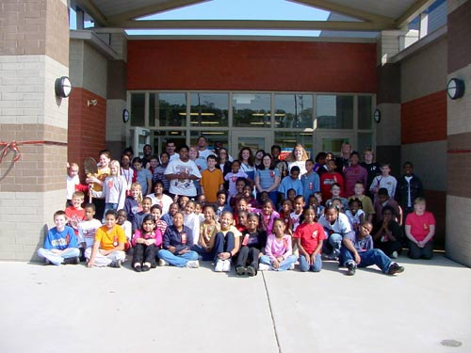
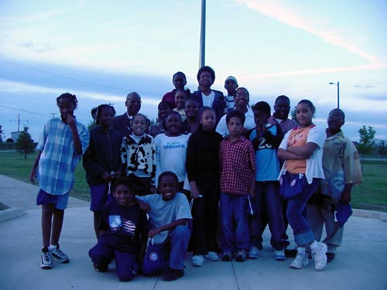
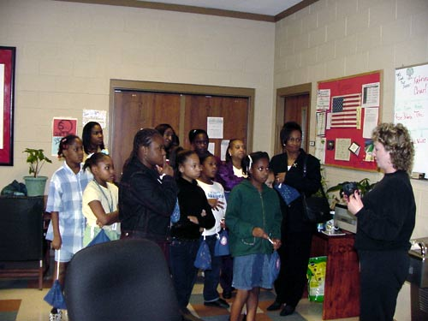
Youth Outreach

Slide 50
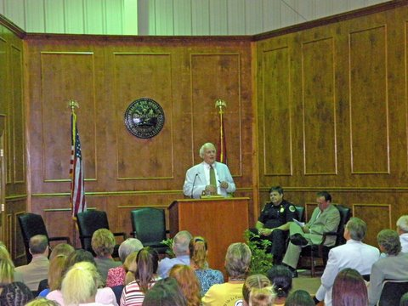
Our Results

Slide 51
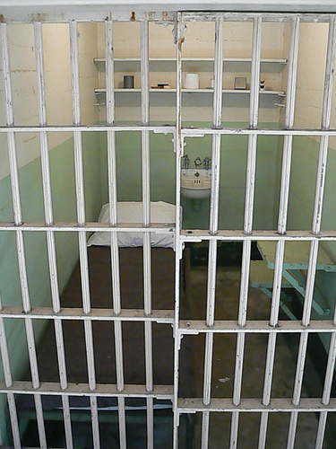
Daily cost of housing an inmate in the Tennessee Department of Corrections
$65

Slide 52
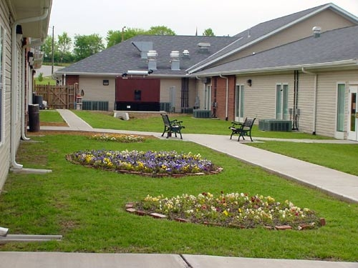
Davidson County Drug Court’s Daily Cost Per Inmate
$48 - $50

Slide 53
Measurable Outcomes
Recidivism Rate
27%
Negative Drug Test Rate
97%
Employment Rate
100%
Number Diverted from the Criminal System
1,350
Tax Payer Savings
Over 30%

Slide 54
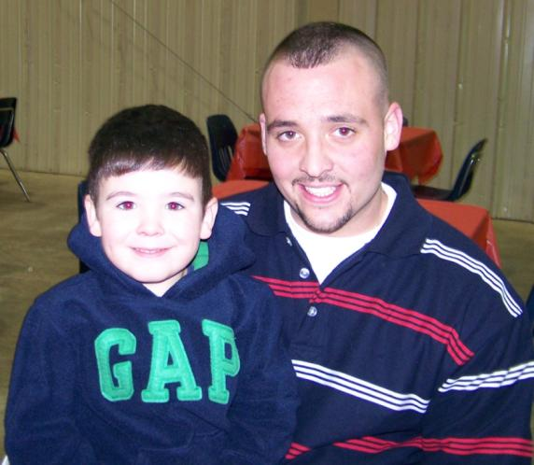
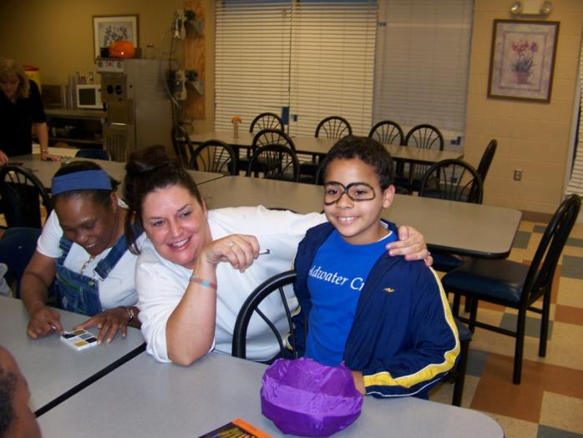
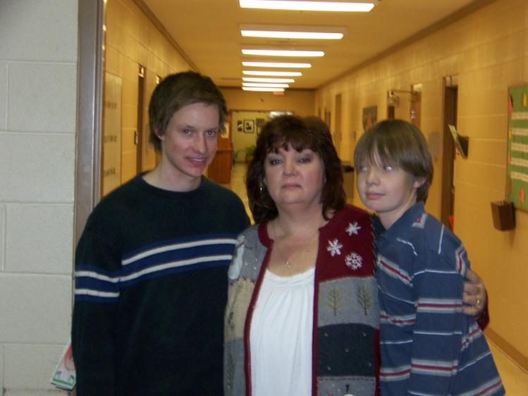
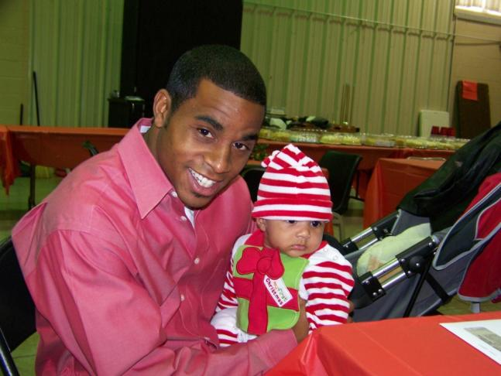
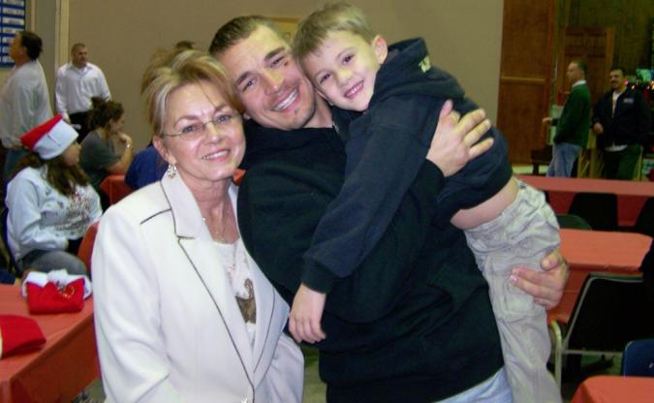
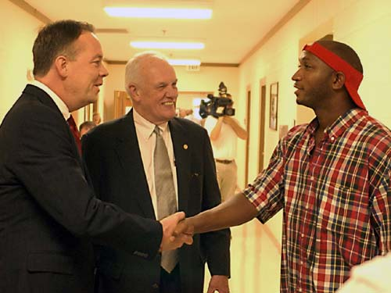

Slide 55
Nashville Drug Court Support Foundation
Davidson County Mental Health Court
Davidson County Drug Court
YOU

Slide 56
Investing in NDCSF
Funding provided by request to the Nashville Drug Court Support Foundation (NDCSF) will ensure the organization maintains critical drug support to Federal, State and Local level agencies.

Slide 57
Contact Information
Nashville Drug Court Support Foundation
Jeri Holladay-Thomas, M.C.J., Director
Davidson County Drug Court
Janet Hobson, M.S., Program Director
Davidson County Mental Health Court
PH: 615.862.4220
PH: 615.313.8480
Tonia Dixon-Gilbert, Program Manager
PH: 615.862.8320
www.nashvilleintegratedcourtsystem.com
http://drugcourt.nashville.gov/

Slide 58

The California Collaborative Justice Courts
Foundation

Slide 59
Introduction & Brief History
Founders: Dianne Marshall and Phil Breitenbucher
Based on the highly successful Mendocino County Friends of Drug Court
Incorporated: October, 2009
IRS Status Approved: October, 2010
Statewide Board of Directors

Slide 60
Board of Directors
President: Dianne Marshall, Therapeutic Courts Administrator, (ret), Mendocino County Superior Court
Secretary: Tonya Clark, Director, Collaborative Court Programs, Superior Court of CA, County of Nevada
Treasurer: Joanne LaCasse, CPA, Ukiah, CA
Phil Breitenbucher, Program Director, Children and Family Futures, Irvine, CA
Charles P. Coovert, President Community Recovery Resources, Grass Valley, CA
David Stevens Hobler, J.D., LLM, Fit in Recovery, Mill Valley, CA
James O. Heiting, Trial Attorney, Managing Partner, Heiting & Irwin, Riverside County, CA
Judge Peggy Hora (ret), Superior Court of CA, County of San Mateo, Senior Judicial Fellow, National Drug Court Institute
Aminta Mickles, Consultant For Change, Independent Consultant , Contra Costa County, CA
Charles Murray, Deputy Trial Counsel, State Bar of California, Los Angeles, CA
Advisor: Judge Albert P. Dover (ret), Superior Court of CA, County of Nevada

Slide 61
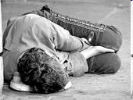
Most People in a
Drug Court Find Themselves:
Jobless
Homeless
Lacking family or community support due to their addiction

Slide 62
Addressing Personal Needs
There are no government agencies or statewide foundations that address the personal needs of children, individuals and families involved in collaborative justice courts in California

Slide 63
The CCJC Foundation
To assist local communities in their support of their treatment courts in meeting unique, unfunded needs of participants striving to satisfy program requirements

Slide 64
Foundation Purpose
To help those supervised by California’s collaborative justice courts become productive community members rather than community costs.

Slide 65
The CCJC Foundation
To assist local collaborative justice courts in meeting unique, unfunded needs of participants striving to satisfy program requirements

Slide 66
How does this effort help?
Drug court foundations:
  Actively demonstrate local efforts towards program sustainability (always requested by BJA).
  Facilitate providing incentives (Design Feature #3)
  Contribute to securing aftercare and assuring community integration by providing funds for GEDs, college textbooks, first month’s rent, tattoo removal and more. (Design Feature #7)
66

Slide 67
How Can This Be Done on a Statewide Basis?
Use of Local Advisory Boards
  - To make the most of locally known contacts,
  - To raise $$$ locally and
  - To oversee the distribution of small grant awards on behalf of local collaborative justice court participants

Slide 68
Why Bother Having a
Statewide Foundation?
In California:
Not every county has its own community foundation.
Establishing a 501-c-3 takes time and energy that especially now with budget cuts may not be available.

Slide 69
We are Positioned to:
    File with the IRS annually
    Provide training in fundraising opportunities to local communities
    Assist Local Advisory Boards in publicizing their efforts

Slide 70
Defining Our Relationship
With the Courts
The issue of judicial ethics must be kept in mind at all times.
This Foundation and its Local Advisory Boards comprise a private, non-profit organization that functions separately from all government agencies.

Slide 71
Establishing a Local Advisory Board
Who do you know:
In your recovery community who is comfortable telling his/her story and is a person of standing in your community?
Who is a family member of a program participant who is also comfortable telling his/her story and is a person of standing in your community?

Slide 72
Judges Make Excellent Members of Your Local Advisory Board
As long as you keep these things in mind:
When sending out fund raising letters or invitations, judges may help by contacting other judges. They may not reach out to the general public.
Judges are excellent for speaking engagements and they will NOT ask for money. That is up to you, if you are allowed, or other members of your local advisory board.

Slide 73
Who are Your Program Graduates in Good Standing?
These individuals have much to offer. They will know:
    Participant needs that, when addressed, make a significant difference in assuring successful outcomes.
    Members of your area who are active in the recovery community who may be willing to help in a myriad of ways.
Notes:
You want your local Advisory Board members to contribute at least two if not all three of the “Ws”: Wealth, Work and Wisdom!
Your local Advisory Board will be assigned a member of the CCJC Foundation Board of Directors to assist you with questions that may arise.
TALK ABOUT THE DECISION MAKING PROCESS FOR AWARDING FUNDS TO INDIVIDUALS.
Use of application (print, copy & distribute)
Advisory Board approval required
Make out checks to vendors or agencies, not to individuals
Maintain records of awards given to report to Foundation & to use in fund raising efforts.
You want your local Advisory Board members to contribute at least two if not all three of the “Ws”: Wealth, Work and Wisdom!

Slide 74
Who is on these
Local Advisory Boards?
People who:
  Already recognize the value of your collaborative courts
  Enjoy making things happen
  Aren’t afraid (or restricted from) fund raising
  Are well-connected

Slide 75
Consider These People:
Current Drug Court Judges
Retired Drug Court Judges
Active or Retired Probation Staff
Active or Retired Treatment Staff
Active or Retired Defense Attorneys including Public
Defenders
Active or Retired Prosecutors
Active or Retired Peace Officers
Drug Court Graduates
Family Members of Program Participants
Prominent Community Members whose sobriety efforts are already known in your community.
Notes:
[1] Judges may ask each other for money. They may NOT ask the general public or anyone else.

Slide 76
Create a Name For Your Fund
Collect $500 - $1,000 for the initial contribution to your fund.
  It is in your best interest to open your fund with a good sum of money.
  Reason: as soon as your local partners know you have a fund to help with participant needs, you will be asked for assistance.
  You want your Local Advisory Board to be able to consider those requests without being depleted

Slide 77
Complete & Submit
  A Field of Interest Agreement (see “Getting Started” on website)
  A Donor Advised Fund Form (see “Getting Started” on website)

Slide 78
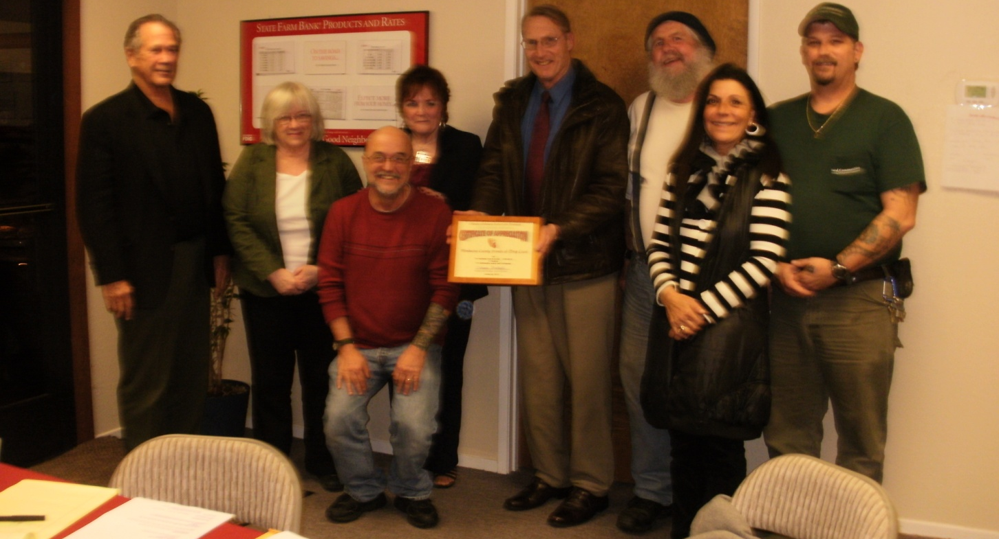
Mendocino County
Local Advisory Board Members

Slide 79
Mendocino County
Friends of Drug Court Fund
Friends of Drug Court was established in May 2005 as a fund under the auspices of the Mendocino County Community Foundation to make grants to organizations that support Drug Court participants and their families in meeting needs not covered by other means.

Slide 80
Who are the Donors?
People you know and people you don’t know
Anonymous donors who read your story in the paper
City Council members after City Council has denied you
Corporations here at the NADCP Conference (Orasure)

Slide 81
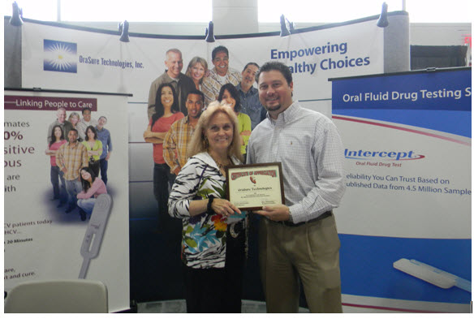
Phil thanking OraSure for a donation at last year’s NADCP Conference

Slide 82
Also…
County Bar Associations
Members of “The Other Bar”
Family members of program graduates
The Soroptomists and PEO as they are interested in helping women

Slide 83
…And
Your Sheriff and District Attorney who may share asset forfeiture funds if you ask.
Judges when asked by another judge
The people with whom you have relationships!!!!

Slide 84
Fundraisers that Work
Local restaurants who will give you a % of an evening’s income (Guy Fieri – Diners, Drive-ins and Dives, Panda Express)
Mark L, the comedian
“Community cards” from local grocery chains
Have a “rent party” to raise rent money to give to participants

Slide 85
Plus a Few More Ideas
Create your own “a-thon”; walk, ride bicycles, jump, or Zumba!
At Christmas or birthdays ask your family and friends to donate to your drug court fund rather than buy you presents.

Slide 86
Planned Giving
Ask people you know who are committed to drug courts to include your fund or foundation in their estate planning!

Slide 87
Most Important Thing for You to Remember When Raising Money…
You have to ask for what you need and after you’ve asked…be quiet.
Let the person who received the question be the next person to speak.

Slide 88
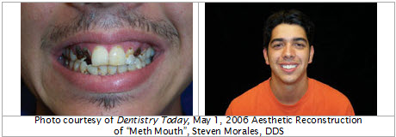
What is the Process of Awarding Grants?
"For the last 2 ½ months I have been getting my teeth fixed with the help of a ‘share-of-cost’ plan. I’ve had 19 teeth pulled, 4 root canals and 4 crowns. Beginning in January though my monthly share is $778. I still need to get my top denture plate & my bottom partial”.

Slide 89
“The dentist said I will lose the bottom teeth he’s fixed if I don’t finish this. Also, I’ve been starting to feel better about myself as my mouth and smile have started to both look and feel better.
Because of my job I’ve been able to save about $550 over the past months. My problem is that I am still lacking about $250 of my co-pay. I feel that I have come so far in getting my dental issues addressed, but need some help in seeing it to completion”.

Slide 90
“If awarded this money I could get… my dentures without undue delay and finally get my smile back. I know that I came into this problem because of my own actions (i.e. my drug use), but I would really appreciate some help here.
Thank you very much for your time and consideration." ~ Eric
Note: Eric’s request for funding was approved by his local advisory board.

Slide 91
Other Positive Outcomes:
A 62-year old male needed batteries for his power scooter. He received the much needed batteries from his Local Advisory Board and was able to get to his assigned treatment groups, AA meetings and has successfully graduated Drug Court. He has since had a successful knee replacement and continues to be a leader in the AA community.

Slide 92
Licensed Vocational Nurse
Two years ago a woman, now 46, asked her Local Advisory Board for funds to further her college courses. She is now, a Licensed Vocational Nurse and earned an AA degree in Psychology. She said, “I am absolutely grateful. Without those funds, I’m not sure where I would be today.”

Slide 93
A Welding Helmet
A 28-year old male requested funds for a welding helmet for welding classes. He is presently an A student, also taking business classes and is a fulltime parent. He states he has many goals for his future and has never been so happy.

Slide 94
And a Few More Requests for Assistance: from Meeting Minutes of the Friends of Drug Court Advisory Board,
Mendocino County, CA
TIRES: Request for $250 for tires for an FDDC client. She is getting $300 from Angel Fund, conditioned on funding from FDC. The Board voted unanimously to approve funding for $200 as long as she can leverage that with Angel Fund donation. Check to be made to Ceja Tires.
Notes:
Be sure request-for-assistance forms are in the hands of the workshop participant when reviewing this section.

Slide 95
Rent
Request for $50 for client portion of rent in Section 8 housing.
Unanimously denied. Rent was already past due at time of Board meeting and funds for the $50 client portion are available from UCC for “rapid re-housing.”

Slide 96
Bicycle Safety Equipment
Request for funds to upgrade bike to night time safety standards by ADC client.
Unanimously approved to spend up to $100 for Dave’s Bike Shop to provide helmet, light and reflective applications to her bike. Dave N. will call Dave’s bike shop to make arrangements. Check to be made to reimburse Dave’s Bike Shop.

Slide 97
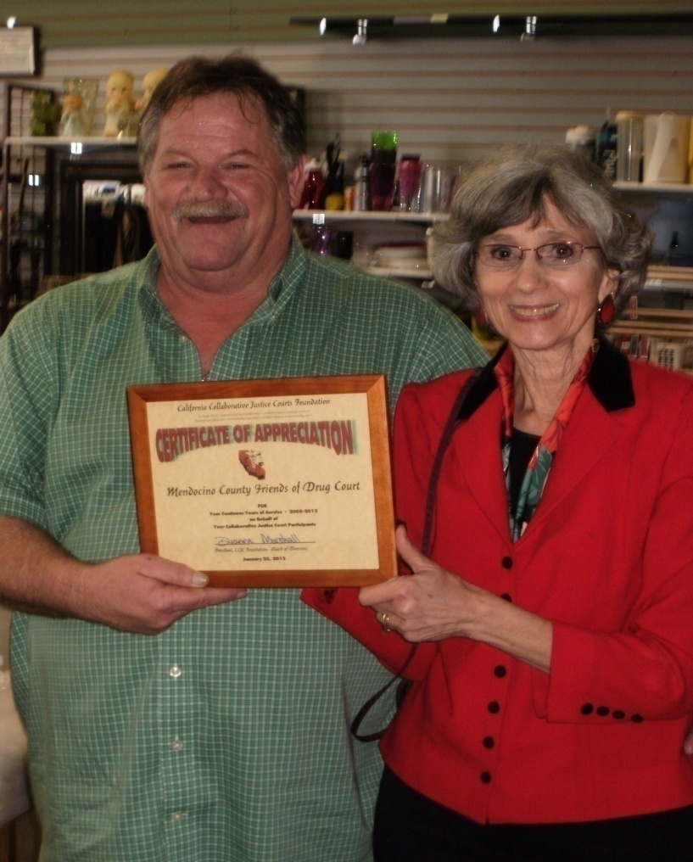
CCJC Foundation recognizes
Mendocino County’s Friends of Drug Court Fund Local Advisory Board

Slide 98

Discussion Points
Steps for working with the IRS
Recruiting Board Members
Judicial Ethics
Getting Focused/Setting Goals
Raising Funds

Slide 99
Discussion Points

Slide 100
Contact Information
Harris County Drug
Court Foundation
Judge Brock Thomas
3217 Montrose Boulevard
Houston, Texas 77006
Email: info@hcdcf.org
Website: www.hcdcf.org
Drug Treatment Court Foundation of Kalamazoo County
Honorable William S. Schma Circuit Court Judge (ret.)
E-Mail: wschma@sbcglobal.net
Phone: (269) 491-2214
California Collaborative
Justice Courts Foundation
Dianne Marshall
E-Mail: donorservices@ccjcfoundation.org
Website: www.ccjcfoundation.org
Nashville Drug Court Support Foundation
Jeri Holladay-Thomas, M.C.J., Director
Phone: (615) 3138480
Website: www.supportnashvilledrugcourt.org
Children and Family Futures
Phil Breitenbucher, MSW, Program Director
Phone: (866) 493 – 2758
E-Mail: pbreitenbucher@cffutures.org

